Slide 1

Data Science Virtual Internship
Data Science :: Healthcare
Persistency of a Drug :: Final Project
Final Presentation
Ugur Selim Ozen
18-Dec-2021

Slide 2
Methodology
1
Data Cleaning and Transformation
2
Exploratory Data Analysis
3
Feature Engineering
4
Model Evaluation
5
Interpreting Results

Slide 3









Utilized Technologies

Slide 4
Background – Healthcare :: Persistency of a Drug
One of the challenge for all Pharmaceutical companies is to understand the persistency of drug as per the physician prescription. To solve this problem ABC pharma company approached an analytics company to automate this process of identification.
Objective : With an objective to gather insights on the factors that are impacting the persistency, build a classification for the given dataset.
The analysis has been divided into 3 parts:
Data-Business Understanding
Finding key insights from dataset about features
Recommendations for pharmaceutical companies

Slide 5
Data Cleaning and Transformation
Total features : 69
Total observations : 3424
Null or Missing values : 0
Dataset size : 1.8 MB
Assumptions:
By checking null values in all features, we can see there is no null values but now we need to focus on much more to observe any missing or unknown value assigned for null values.
This is a classification problem so we can impute null or missing values generally with two approaches ; first one is filling with most recurring value (mode) and second one is we can categorize the missing values with some value like ‘Missing' or ‘Unkown’.
In this dataset null or missing values were filled ' Unkown' value therefore we can apply first method which is filling with mode.
Filling with mode operation is made for only 4 columns ; Race , Ethnicity , Region and Ntm_Speciality because in other columns , ratio of 'Unknown' is more than %50 that means 'Unknown' itself is mode in column so it can be meaningless and not correct operation for other columns.
Generally, for the classification problems we can have imbalanced dataset in real-life , we can say that this dataset is imbalanced, so we need to apply oversampling or undersampling methods in model building step.

Slide 6
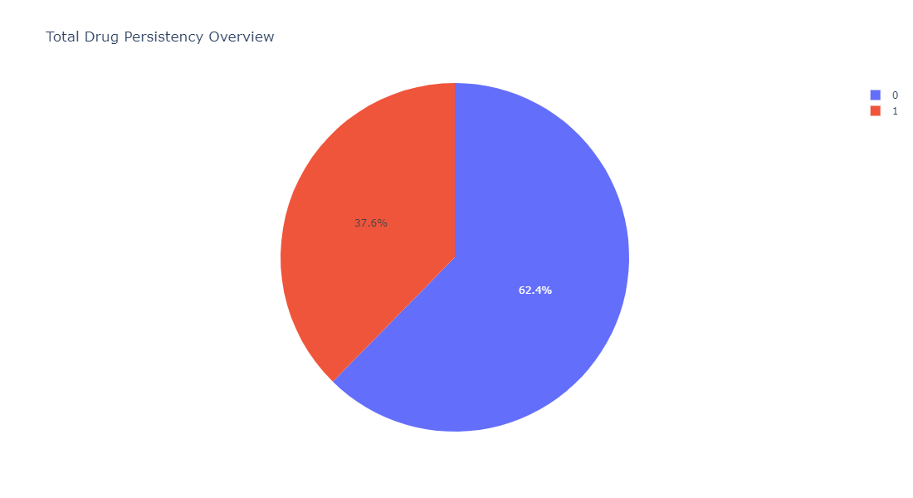
⚫ As seen from this Pie Chart; The total number of non-persistent drug is approximately 1.7 times that of persistent drug, so it means that dataset is imbalanced.
Total Drug Persistency Analysis

Slide 7
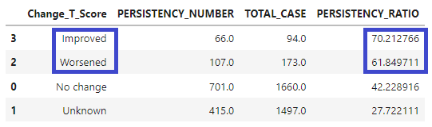
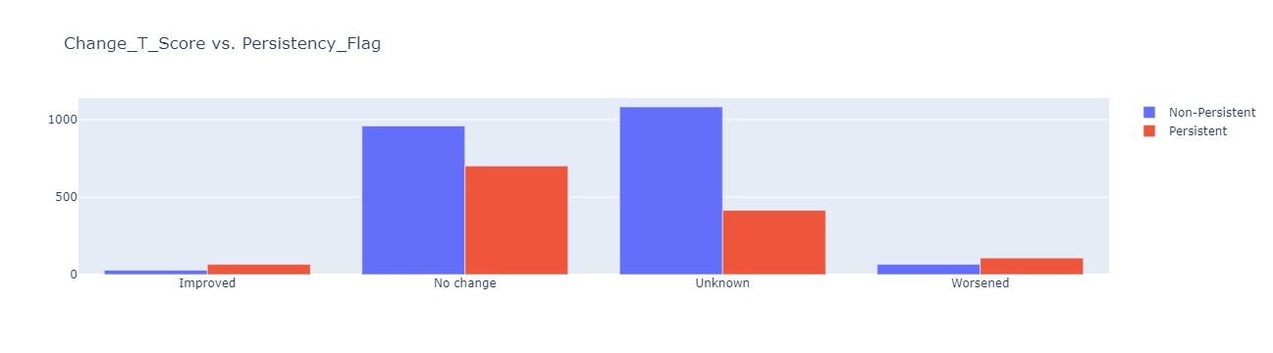
Change_T_Score

Slide 8
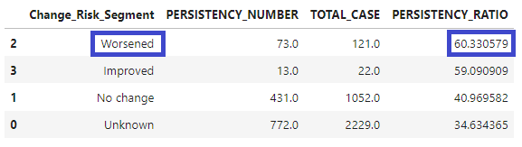
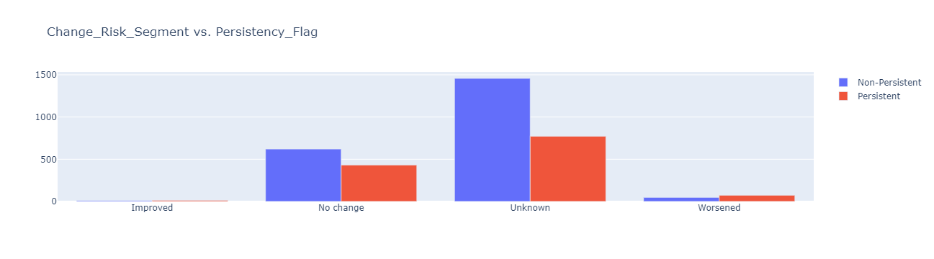
Change_Risk_Segment

Slide 9
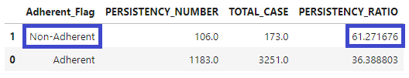
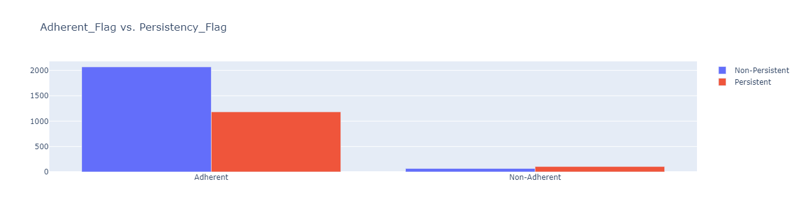
Adherent_Flag

Slide 10
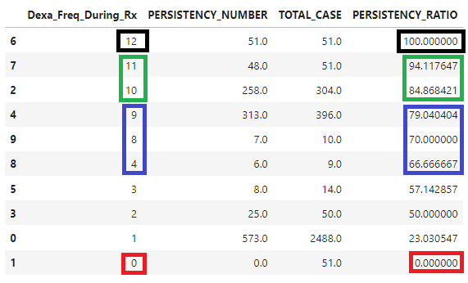
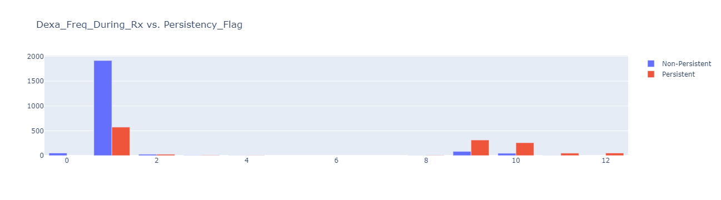
Dexa_Freq_During_Rx

Slide 11

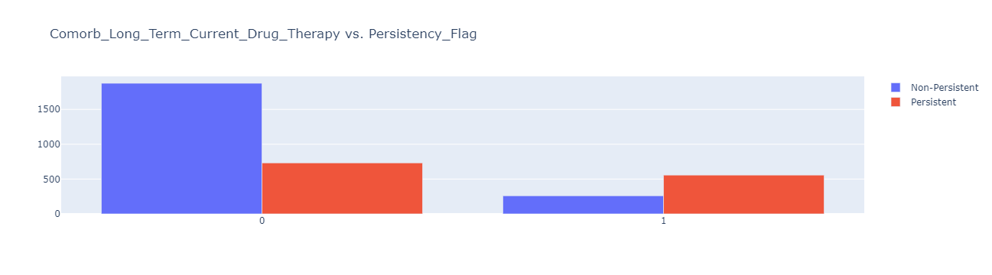
Comorb_Long_Term_Current_Drug_Theraphy

Slide 12
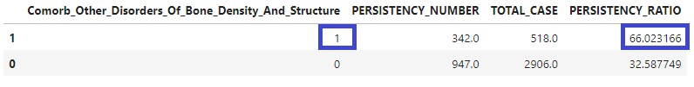
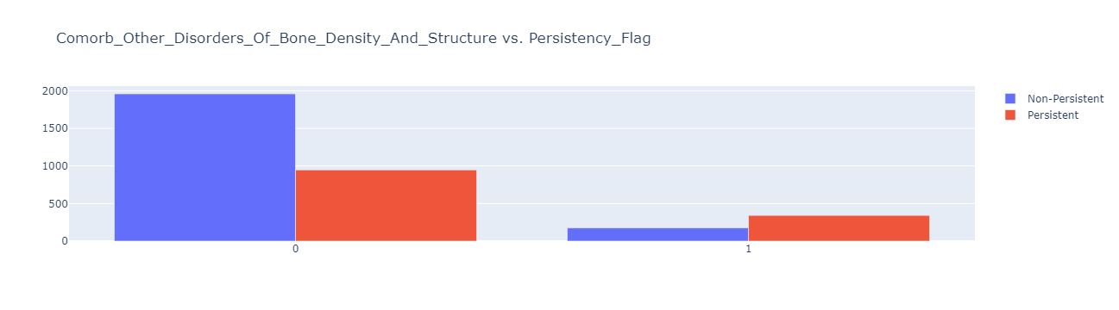
Comorb_Other_Disorders_of_Bone_Density_and_Structure

Slide 13
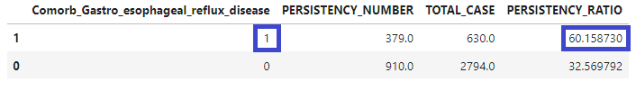
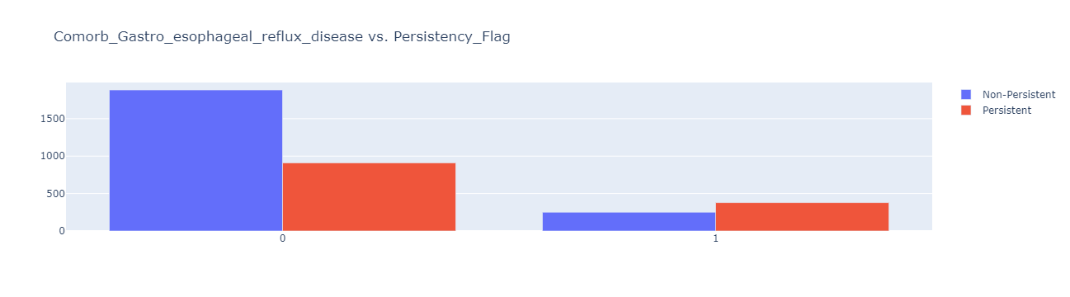
Comorb_Gastro_Esophageal_Reflux_Disease

Slide 14

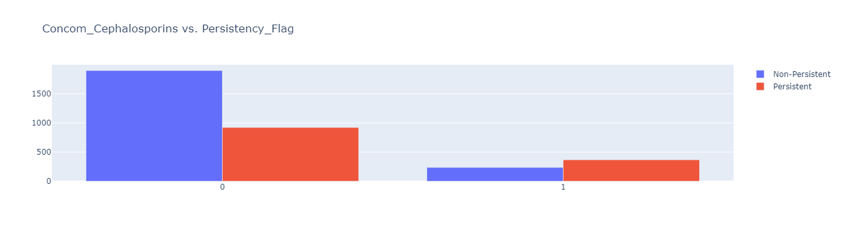
Concom_Cephalosporins

Slide 15


Concom_Macrolides_and_Similar_Types

Slide 16
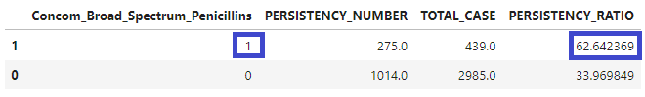
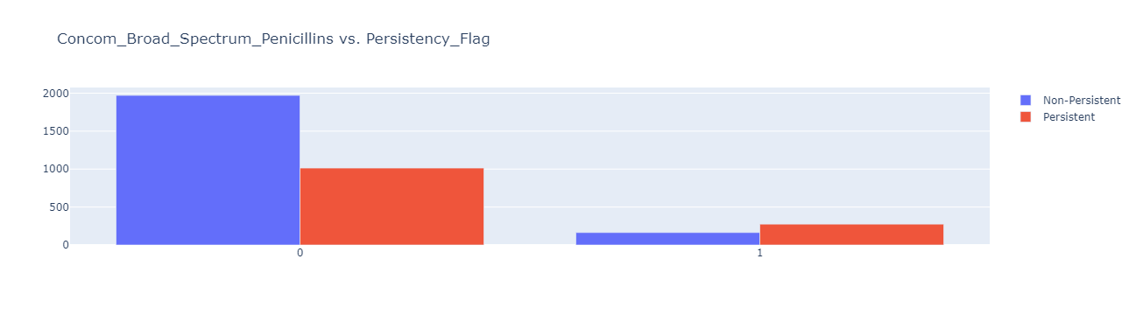
Concom_Broad_Spectrum_Penicillins

Slide 17


Concom_Anaesthetics_General

Slide 18


Concom_Viral_Vaccines

Slide 19
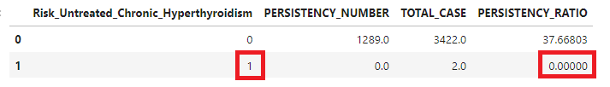
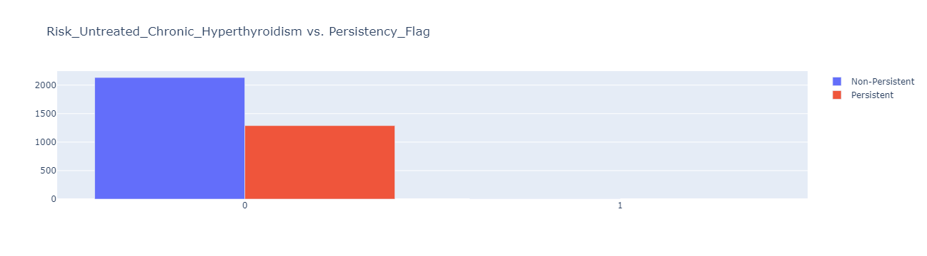
Risk_Untreated_Chronic_Hyperthyroidism

Slide 20
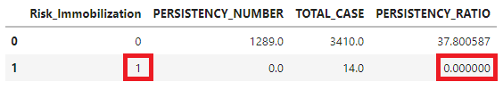
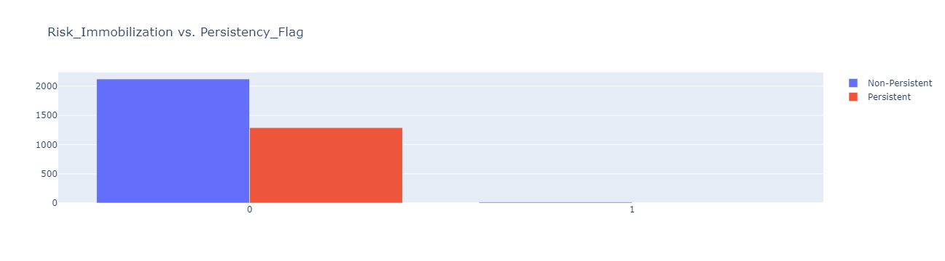
Risk_Immobilization

Slide 21
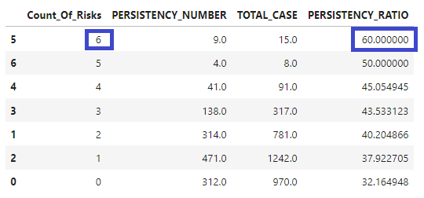
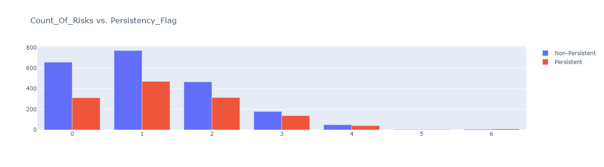
Count_of_Risks

Slide 22
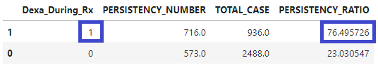
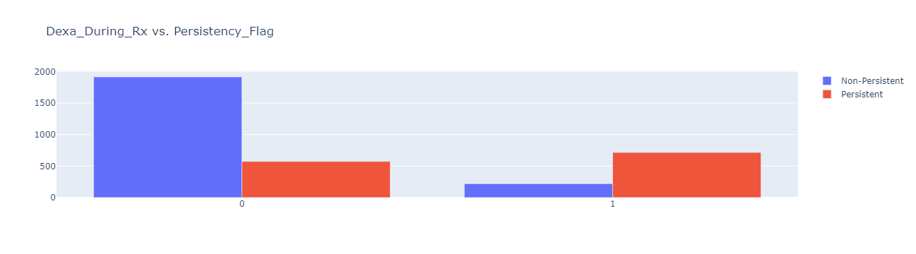
Dexa_During_Rx

Slide 23
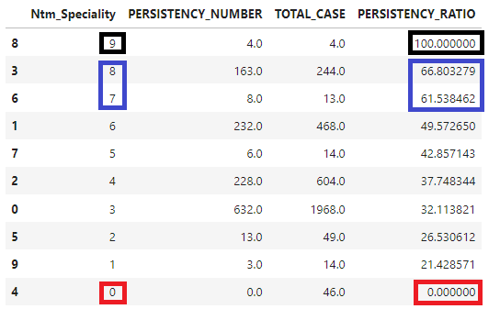
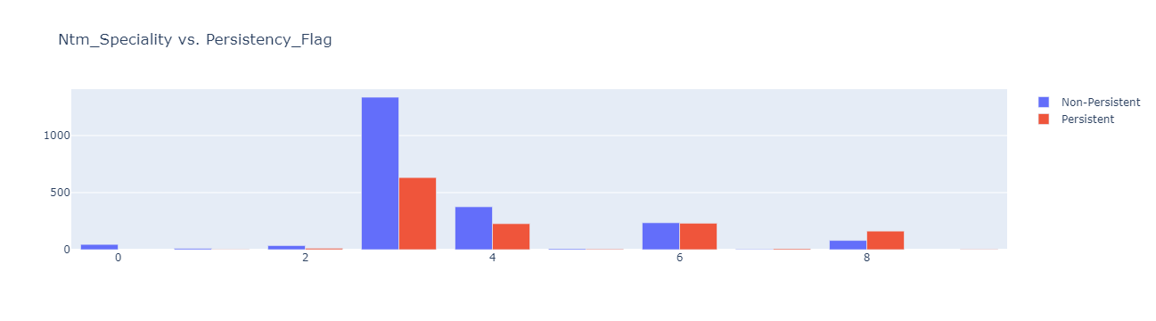
Ntm_Speciality

Slide 24
Final Recommendations-I
1. Following features are certainly (%100) has PERSISTENT value so if your case has following values you have caught some wanted cases ;
• Ntm_Speciality = 9
• Dexa_Freq_During_Rx = 12
2. Following features are very likely (%80-%100) has PERSISTENT value so if your case has following values you may caught some wanted cases ;
• Dexa_Freq_During_Rx = 10
• Dexa_Freq_During_Rx = 11
3. Following features are likely (%60-%80) has PERSISTENT value so if your case has following values it is possible that catching some wanted cases ;
• Ntm_Speciality = 7
• Ntm_Speciality = 8

Slide 25
Final Recommendations-II
• Dexa_During_Rx = 1 (Yes)
• Count_Of_Risks = 6
• Concom_Viral_Vaccines = 1 (Yes)
• Concom_Anaesthetics_General = 1 (Yes)
• Concom_Broad_Spectrum_Penicillins = 1 (Yes)
• Concom_Macrolides_And_Similar_Types = 1 (Yes)
• Concom_Cephalosporins = 1 (Yes)
• Comorb_Gastro_esophageal_reflux_disease = 1 (Yes)
• Comorb_Other_Disorders_Of_Bone_Density_And_Structure = 1 (Yes)
• Comorb_Long_Term_Current_Drug_Therapy = 1 (Yes)
• Dexa_Freq_During_Rx = 4
• Dexa_Freq_During_Rx = 8
• Dexa_Freq_During_Rx = 9
• Adherent_Flag = 'Non-Adherent'
• Change_Risk_Segment = 'Worsened'
• Change_T_Score = 'Improved'
• Change_T_Score = 'Worsened'

Slide 26
Final Recommendations-III
4. Following features are certainly (%100) has NON-PERSISTENT value so if your case has following values there is no need to focus on it anyway ;
• Ntm_Speciality = 0
• Risk_Immobilization = 1 (Yes)
• Risk_Untreated_Chronic_Hyperthyroidism = 1 (Yes)
• Dexa_Freq_During_Rx = 0

Slide 27
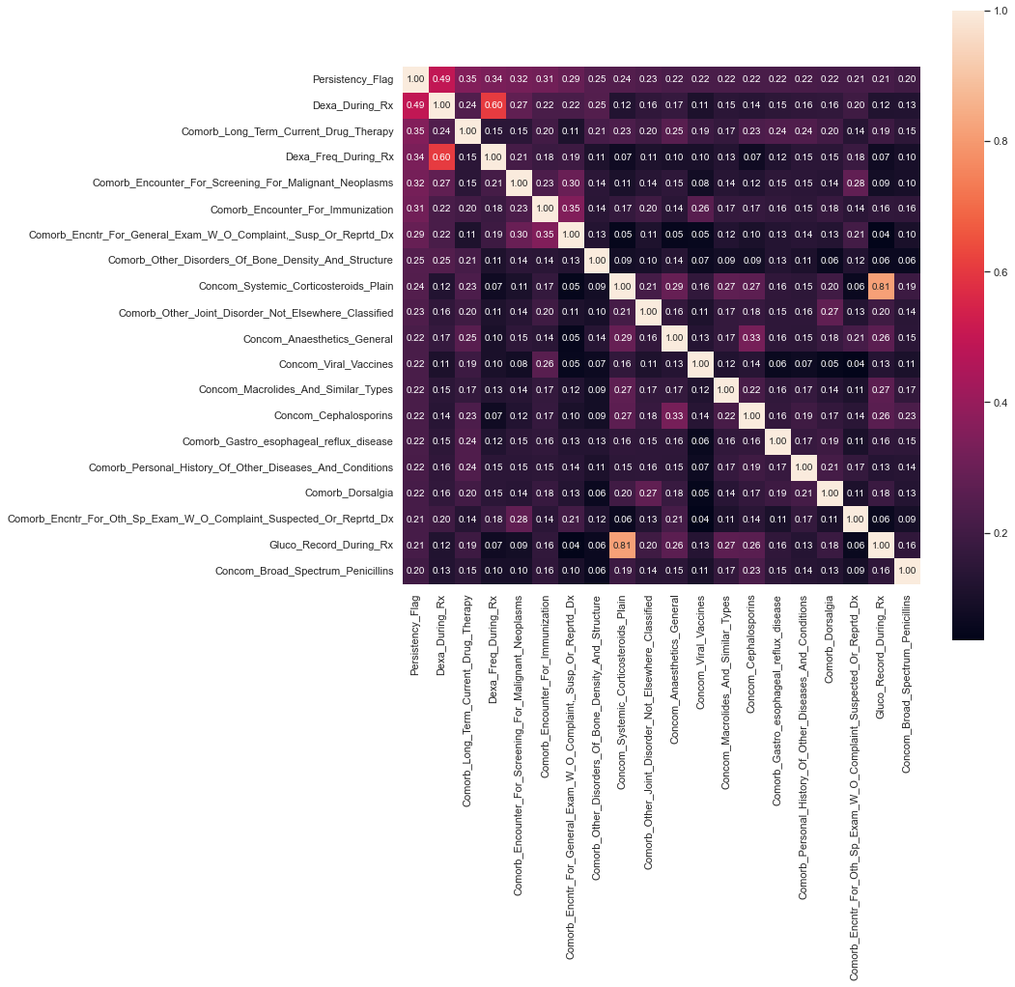
Correlation Heatmap

Slide 28
Recommended Modeling Technique
• For this dataset , modeling will be made with 67 features using OneHotEncoding and oversampling methods.
• 3 features ( Count_Of_Risks , Ntm_Speciality , Dexa_Freq_During_Rx ) have transformed in feature engineering step and any extra column has not derivated from dataset.
• I am planning to use following machine learning algorithms in dataset modelling step (train-validation-test) ;
1. Decision Tree Classifier
2. Random Forest Classifier
3. Logistic Regression
4. CatBoost Classifier
%60 %20 %20
%60 %20 %20

Slide 29
Model Prediction Test Results
Model Algorithm | Recall - 0 | Recall - 1 | F1 Score - 0 | F1 Score - 1 | 5-Fold Cross Validation Recall | 5-Fold Cross Validation F1 Score
Decision Tree Classifier | 0.79 | 0.57 | 0.79 | 0.57 | 0.624 | 0.622
Random Forest Classifier | 0.89 | 0.67 | 0.87 | 0.70 | 0.615 | 0.674
Logistic Regression | 0.86 | 0.75 | 0.87 | 0.73 | 0.651 | 0.686
CatBoost Classifier | 0.91 | 0.67 | 0.88 | 0.72 | 0.635 | 0.695

Slide 30
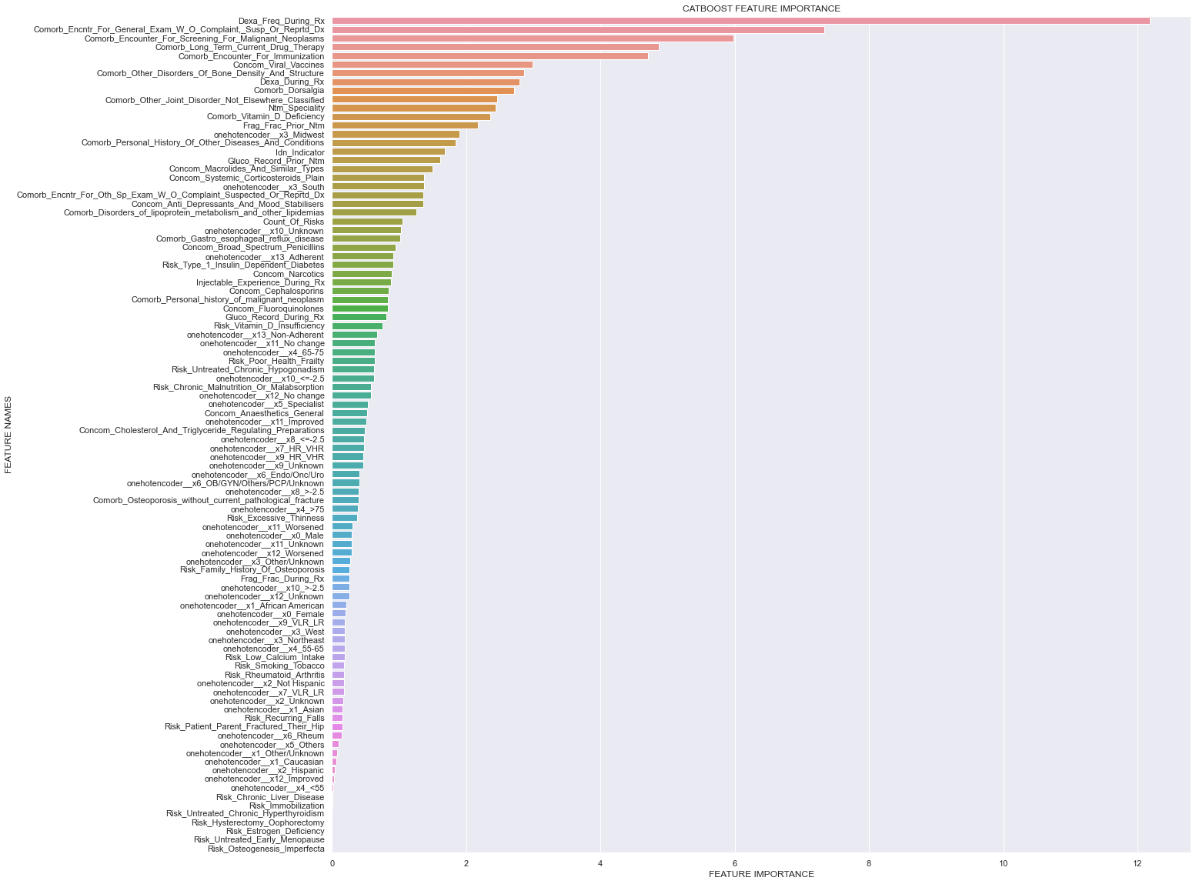
Feature Importance

Slide 31
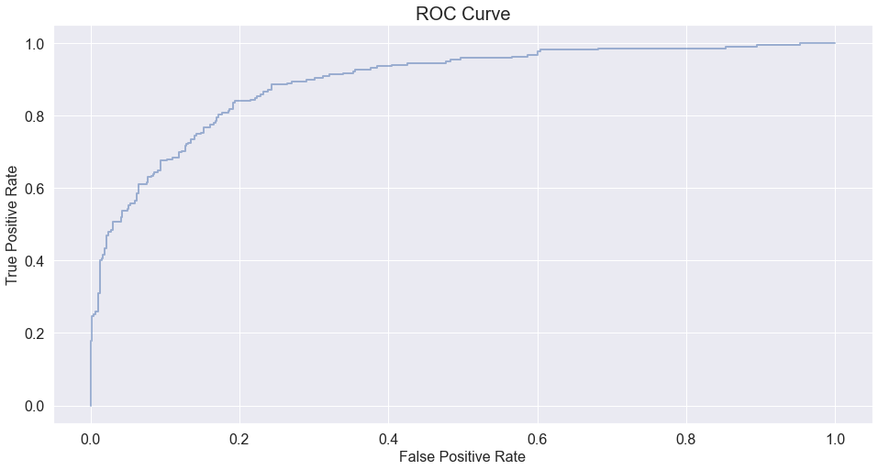
ROC Curve

Slide 32
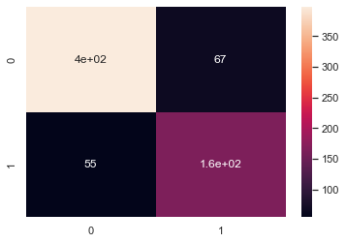
Interpreting Results
I have decided to use Logistic Regression model.It is very fast and stable according to CatBoost Classifier model also it’s Recall- 1 score is greater than CatBoost one. That means we can have more gain by catching the true positive cases.
Selected Model Confusion Matrix

Slide 33
Thank You

